Slide 1

City Search

Slide 2
City Research
Home
Tableau Dashboard
Machine Learning
Static Reports
Useful Links
City:
Enter a City

Slide 3
Tech Jobs USA
City Research
Home
Tableau Dashboard
Machine Learning
Static Reports
Useful Links
City:
De
City | State | House Price | Median Rent | Unemployment | Population
Denver | CO | 320,000 | 1,654 | 3.4% | 1,709,928
Des Moines | IA | 235,000 | 1,252 | 3.8% | 1,108,000
Detroit | MI | 210,000 | 1,189 | 4.5% | 1,890,278

Slide 4
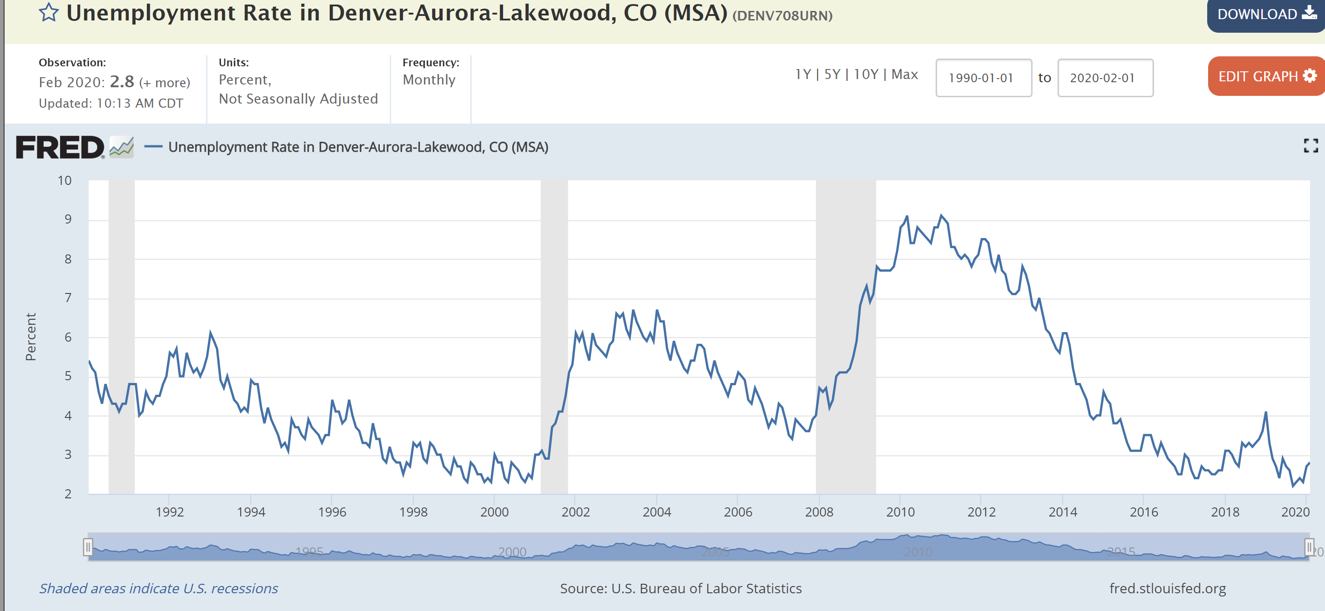
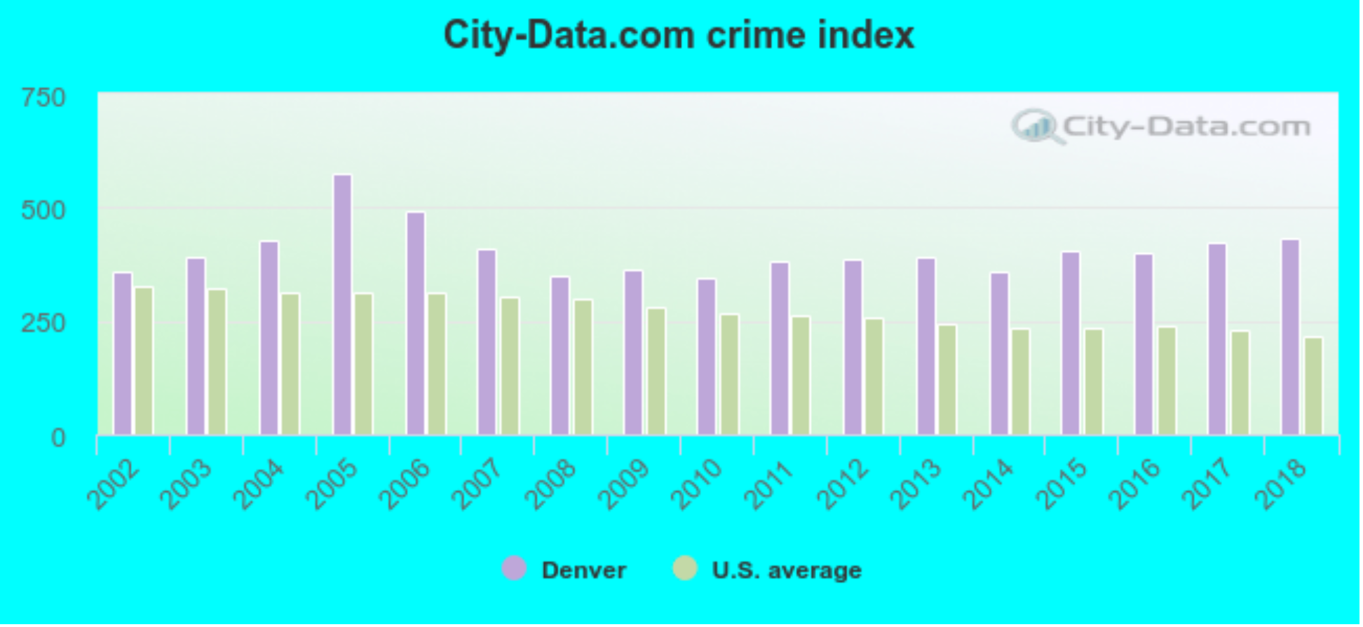
City Research
Denver, CO - Insights
Home
Tableau Dashboard
Machine Learning
Static Reports
Useful Links
Overall Ranking: #5
Facts and Numbers
Population
678,467
+17.4% since 2010
Unemployment Rate
3.4%
Median Income
$51,800
Median Home Price
$426,200
Median Age
34.4
Comfort Index (Climate)
7.3/10

Slide 5
City Research
Tableau Dashboard
Home
Tableau Dashboard
Machine Learning
Static Reports
Useful Links

Slide 6
City Research
Machine Learning ….
Home
Tableau Dashboard
Machine Learning
Static Reports
Useful Links

